Slide 1

GLA UNIVERSITY, MATHURA-281406

Slide 2
Blood Point
A project report on

Slide 3
Department of Computer Science and Engineering
Submitted By:
Kunal Bhardwaj, 2115000560
Harsh Tripathi, 2115000450
Sagar Jain, 2115000889
Kaushal Chauhan, 2115000524

Slide 4
Introduction
The primary purpose of the Blood Point Project is to educate and raise awareness about the importance of blood in our body ,its function , and its composition.
This project aims to :
Educate : Provide comprehensive knowledge about the blood , its components , and its vital role in human health
Raise Awareness : Highlight the importance of maintaining healthy blood levels and the impact of various blood disorders.
Promote Health : Encourage healthy lifestyle choices to maintain optimal blood health and prevent diseases
Encourage Blood Donation : Through understanding the importance of blood , we hope to inspire more people to donate blood and save lives.

Slide 5
Objective
The objective of blood Bank Management System project ,also known as the “Blood Point” project , is o automate the existing manual system with the help of computerized equipment and software
The main goals of the project are :
1.To manage daily transaction of the blood bank and search the details efficiently.
2.To reduce the error and increase security , speed in the management system.
3.To maintain computerized record without redundant entries.
4.To provide transparency in the field of blood bank management.
5.To reduce the deaths due to the lack of blood during operations .

Slide 6
Problem statement
Globally blood transfusion contributes to saving millions of live every year improve life expectancy and the quality of life of patients suffering from life threatening condition. By providing a user friendly platform that connects donors,blood donation camps , hostpital etc.
The addressing of the project are :
1.Personal Profile Accessibility : The donor’s information can only be updated by the administrators of the blood bank .A donor can update their information by calling , faxing, but not by themselves.
2.Lost or Damaged Card : If the card gets stolen or lost ,the donor must make a replacement card to keep their membership at the blood bank.

Slide 7
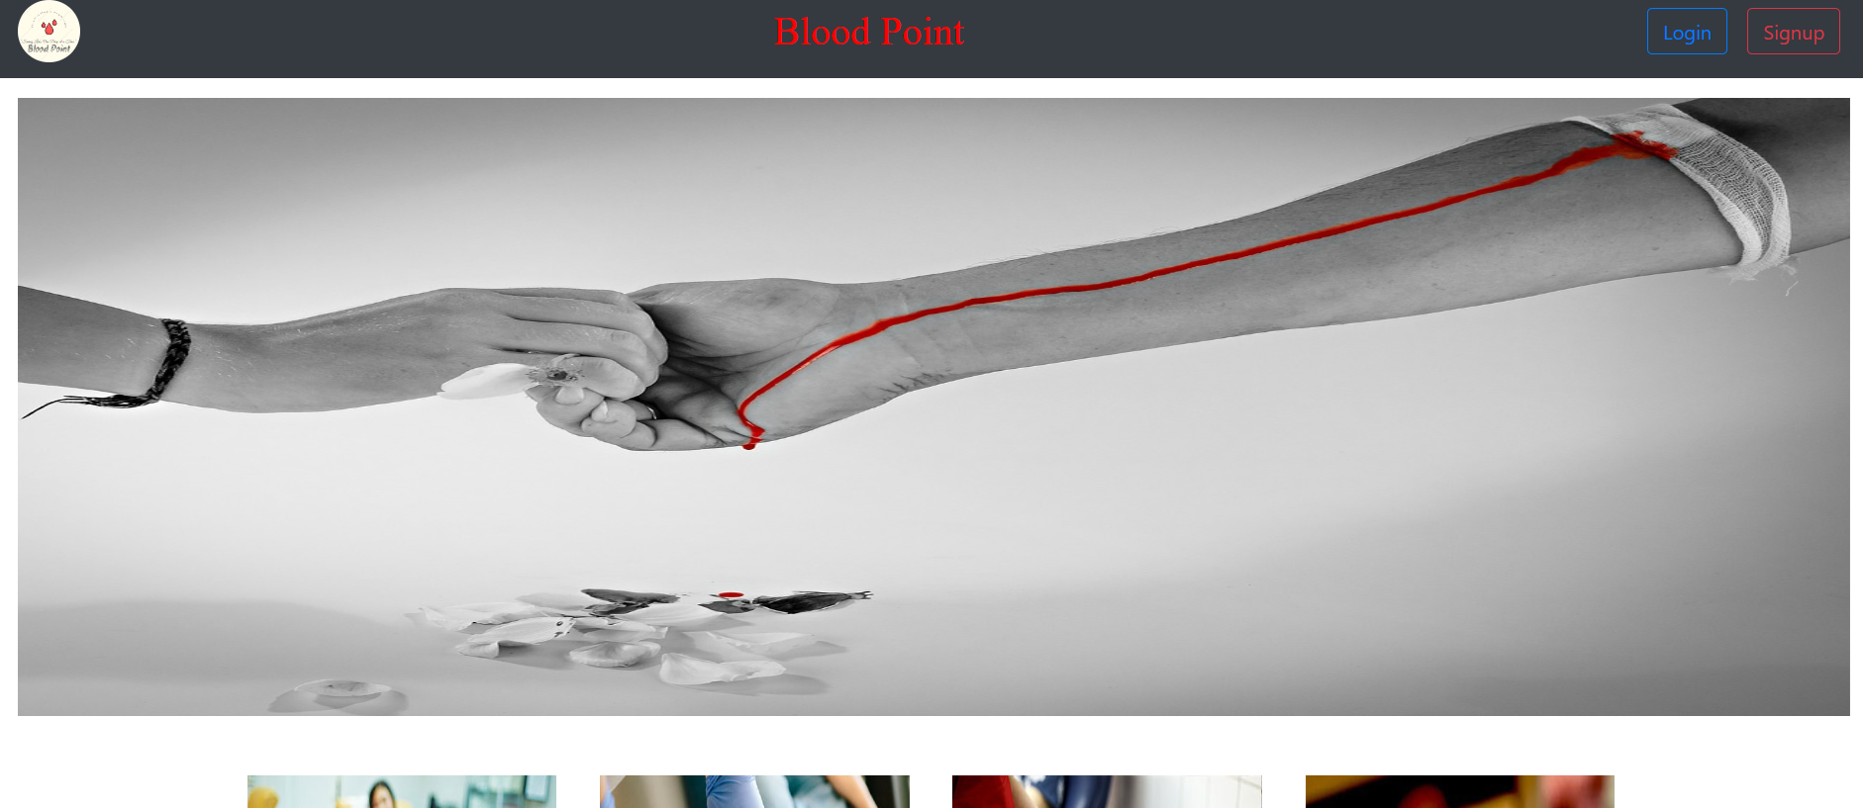
Result

Slide 8
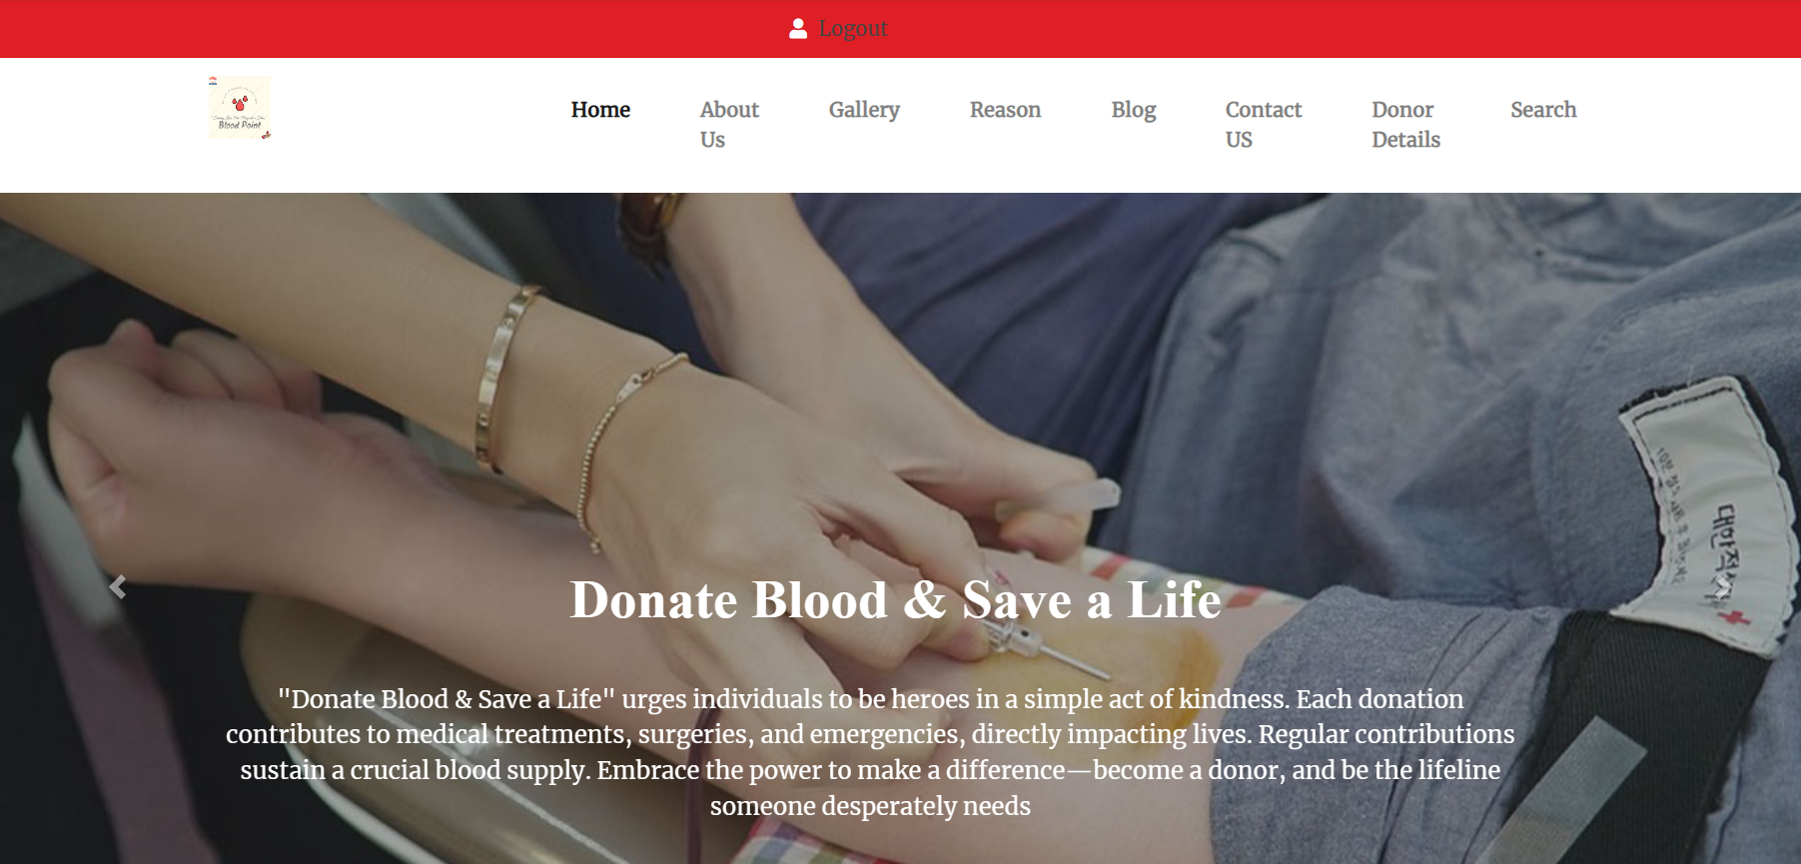
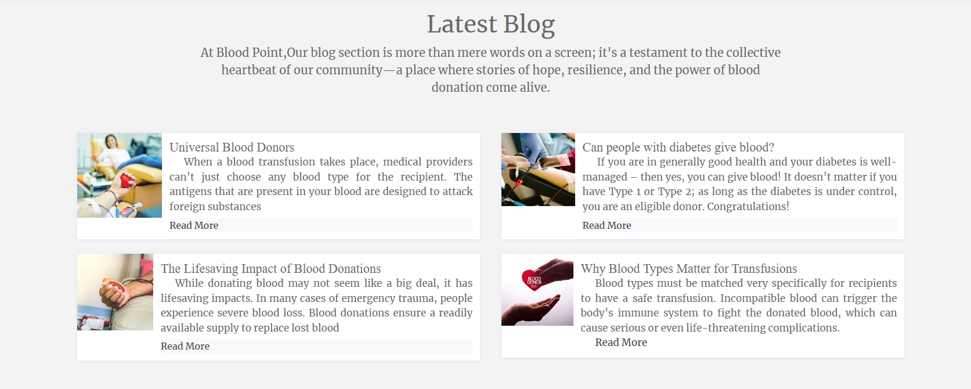

Slide 9
Literature Review
1.Inssen by Amine – Smahi : Inssen is an open source blood donation app available for android smartphone that searches notifies and connect thousands of blood donors in three simple steps
2.Blood bank management system by sumitkumar1503: This online system is built for the blood donation organization to manage the blood bank system.
The gap that is blood point project file is primarily in the area od accessibility and convenience for both donor and recipients .Traditional blood bank system have several limitations such as personal profile ,lost or damaged card etc
It also enables blood bank to manage donor information, donation record ,blood stocks ,and hostpital requests efficiently.

Slide 10
Technologies Used
Interactive Learning: Using HTML, CSS, and JavaScript, the project aims to create an interactive and engaging platform for users to learn about blood, its components, and its functions in the human body.
Data Management: With PHP and MySQL, the project manages user data, quiz scores, and other relevant information. This allows for personalized learning experiences and progress tracking.
Accessibility: Hosted on a XAMPP server, the project can be easily accessed by anyone with an internet connection. This promotes widespread education and awareness about the topic.
Community Engagement: The project could also include features like discussion forums, Q&A sections, and even a platform for arranging blood donation camps, all managed using PHP and MySQL.

Slide 11
Project Design
User Interface (HTML, CSS, JavaScript): The user interface is the front-end part of the application where users interact with the system. It includes the layout, typography, colors, buttons, forms, and other visual elements. JavaScript is used to make the interface interactive and responsive.
Server-Side Processing (PHP, MySQL): PHP is used for server-side processing. It handles form submissions, database operations, user authentication, and more. MySQL is used as the database management system where all the data related to the project, such as user information, blood points data, etc., are stored and retrieved.
Local Server (XAMPP): XAMPP is a software distribution which provides an easy way to install Apache distribution containing MySQL, PHP, and Perl. It is used to host the application locally during the development phase.

Slide 12
Project Design
4. Blood Point Management: This is the core of the project. It involves managing the data related to blood points, such as tracking the blood points of each user, updating the points when a user donates blood, etc.
5. User Management: This involves managing user data, including registration, login, profile management, etc.
6. Educational Content: The project also includes educational content about blood, its importance, blood donation, etc. This content is displayed to the users through the user interface.

Slide 13
Demonstration
User Interface: Show the layout and design of the application, including the home page, learning modules, user profile, and other pages.
Interactive Learning: Demonstrate how users can interact with the learning modules, take quizzes, and earn blood points.
User Management: Show the registration and login process, profile management, and how users can track their progress.
Blood Point Management: Demonstrate how blood points are earned, tracked, and used within the application.
Community Engagement: If applicable, show the discussion forums, Q&A sections, and the platform for arranging blood donation camps.

Slide 14
Challenges Faced
Technical Challenges: Implementing a web-based application using HTML, CSS, JavaScript, PHP, MySQL, and XAMPP server can present technical challenges, especially for those who are new to these technologies.
Data Management: Managing user data, blood points data, and other relevant information in a secure and efficient manner can be challenging.
User Engagement: Creating an interactive and engaging platform that effectively educates users about blood and its importance can be a difficult task.
Coordination: Coordinating among different blood banks, hospitals, and NGOs that work in isolation can be a challenge.

Slide 15
Challenges Faced
5. Stakeholder Engagement: Ensuring stakeholder engagement can be a challenge. Stakeholders need to be involved in the project planning process .
6. Resource Constraints: There might be constraints related to time, budget, and human resources which can pose challenges .
7. Cultural Resistance: There can be resistance from fellow clinicians, as well as resistance stemming from a hospital’s “culture.” Providing education, creating enthusiasm, and engaging and empowering staff can drive success in overcoming hesitance.

Slide 16
Conclusion
In conclusion, the Blood Point Project is a comprehensive web-based application designed to educate and raise awareness about the importance of blood in our body. Developed using HTML, CSS, JavaScript, PHP, MySQL, and hosted on a XAMPP server, this project provides an interactive and engaging platform for learning. It effectively manages user data and promotes community engagement. Despite the challenges faced during development, the project serves as a valuable resource for anyone interested in biology, health sciences, or personal health. It not only enhances our understanding of the body’s functions but also promotes the noble cause of blood donation. I hope this helps! Let me know if you need more information.

Slide 17
Acknowledgments
“ Blood Point “ is an android application designed to facilitate blood donation. it allows users with an android phone and an active internet connection to contact and search for donors easily. The main purpose of this application is to assist people in rural areas .
Here are some of the features of the Blood point application.
Easy contact between blood donor and recipient.
User Database
User Login and sign up.
Donor Details
Finding blood group easily

Slide 18
Question & Answere
Certainly! I'd be happy to answer questions about the "Project Blood Point." Please go ahead and ask any questions you have, and I'll do my best to provide information and insights.

